Slide 1
Algebra 4
Day 75

Slide 2
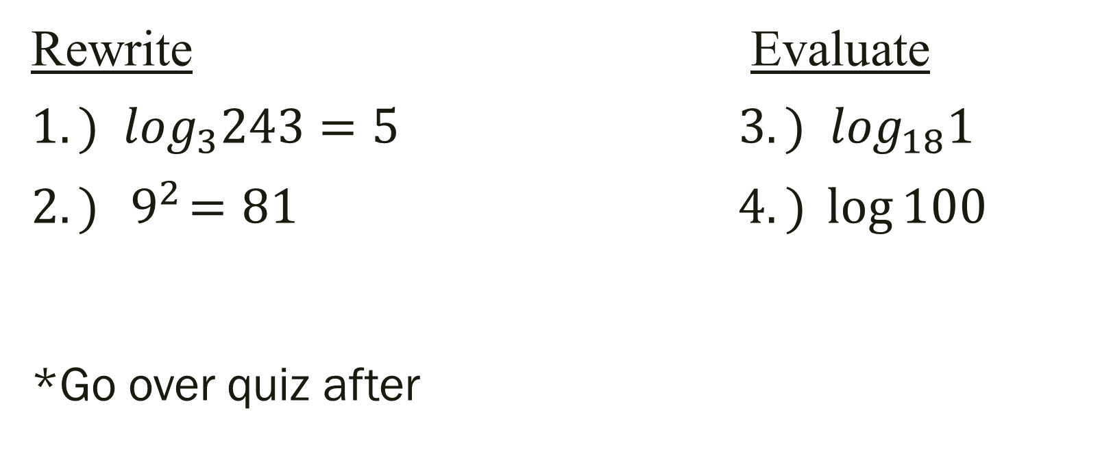
Bell Work
Rewrite Evaluate
$${1.) log}_{3}243=5{ 3.) log}_{18}1$$ $2.){ 9}^{2}=81$ $4.) \log{100}$
*Go over quiz after

Slide 3
From Last Time
finish previous 2 assignments
(there was no new one after the quiz… only the optional assignment)

Slide 4
7.5 Exponential and Log Equations
Objective:
Solve exponential and log equations

Slide 5
Strategies to Solve:
Isolate the exponential or logarithmic function first! Then:
1.) One to One: rewrite so the bases are the same and compare
2.) Rewrite exponential in log form and apply the Inverse Property
3.) Rewrite log in exponential form and apply the Inverse Property

Slide 6

Examples: Solve
${1.) 3}^{x}=81$
2a.) ln x–ln 2 = 0 2b.) $\log_{9}$x–$\log_{9}$ 2 = 0
${3.) 2}^{x}+4=12$
${4.) 5log}_{6}{2x=20}$

Slide 7
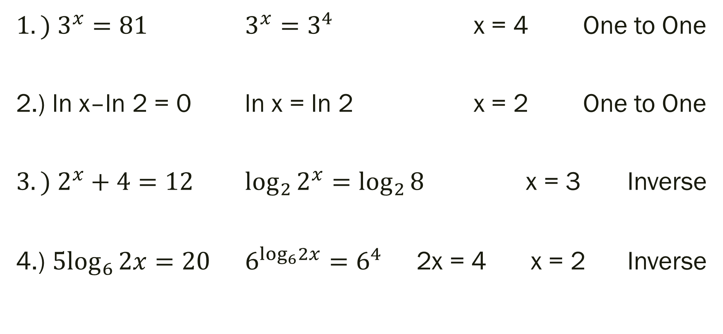
Examples
${1.) 3}^{x}=81$ $3^{x}=3^{4}$ x = 4 One to One
2.) ln x–ln 2 = 0 ln x = ln 2 x = 2 One to One
${3.) 2}^{x}+4=12$ $\log_{2}{2^{x}=\log_{2}{8}}$ x = 3 Inverse
4.) ${5log}_{6}{2x=20}$ $6^{\log_{6}2x}=6^{4}$ 2x = 4 x = 2 Inverse

Slide 8
For Next Time
Page 473 #1–5, 7–23 (odd)

